Slide 1
Voter Service and Polling Center ePollbook
Administration user guide

Slide 2
VSPC ePollbook
Requirements
Chrome: Current version recommended (may use preceding version)
Microsoft Edge: Current version
Firefox: Current version recommended (may use preceding version)
Internet Explorer: No longer allowed to be used. It is not secure and not supported.
A PDF viewer is REQUIRED to view and print ballot labels (Adobe Reader recommended)
“Active X“: If your county uses Ballot-On-Demand your IT will need to add an IE extension in Chrome to allow access to Ballot-On-Demand. The extension used:
https://chrome.google.com/webstore/detail/ie-tab/hehijbfgiekmjfkfjpbkbammjbdenadd
Refer to the “VSPC Setup Checklist & Setup Guide" for the IE extension and other essential setup tasks.
Note: Printer settings for ballot labels may need to be adjusted in order to be read by a handheld scanner.

Slide 3
Instructions for Online Election Judge Training
All Election Judge Classes are accessed from the SCORE 3.0 Dashboard which does require an Active SCORE user account
All Election Judge classes no longer require a separate login.
The classes are accessed by logging into SCORE 3.0 and selecting the Judge Training link located on the SCORE 3.0 Dashboard.
Cyber Security
VSPC Set up and Management
VSPC ePollbook Admin
VSPC ePollbook Judge
Issuing and Replacing a Mail Ballot
Issues in Voter Registration
Signature Verification
Voter Intent
Watchers and Observers
What does this mean for you?
Judges only need their SCORE username, password and grid card to take SCORE/ePollbook/All Election Judge classes.
We encourage you to look through ALL the classes so you can see what the judges see and anticipate any questions they might have.

Slide 4
Online Training for Election Judges and Staff
Election Rule 6.5 For purposes of training election judges, an “election cycle” means all elections held during a calendar year beginning January 1 and ending December 31.
Election Rule 6.7 requires VSPC supervisor judges to complete a training course provided or approved by the Secretary of State.
Election Rule 6.8 A signature verification judge must complete a training course conducted by the county clerk at least once per election cycle. The Secretary of State must provide or approve the training content.
NOTE: All election staff, temporary workers and election judges that have access to SCORE and/or ePollbook must read and sign the SCORE End User Acceptable Use Policy on Clerk’s Corner: (login) → SCORE → System requirements & network security → Security
The signed forms are kept on file with the county clerk. As a reminder, SANS Securing the Human training is required for all active SCORE users that are full-time, part-time or temporary county staff. (Election Judges take the Election Judge Cyber Safe Security Training.)
Mandatory background checks
Election Rule 6.9 The county clerk must arrange for a criminal background check on each supervisor judge and each staff member with access to SCORE or electors’ confidential or personally identifiable information.
Optional but highly recommended online trainings
If VSPC supervisor judges will be expected to use SCORE Classic to register voters and issue mail ballots (as a contingency in the event of loss of connectivity to ePollbook), then the following online course is highly recommended:
SCORE Issuing and Replacing a Mail Ballot
Temporary election staff members who will process registrations in SCORE Classic should complete the following recommended online course:
Issues in Voter Registration
County election staff who process voter registrations or issue ballots should complete the optional training courses listed above (if they have not already done so), and also complete the following online courses:
VSPC ePollbook Judge
VSPC ePollbook Administration (*only recommended for the designated staff member(s) who will perform administrative functions in ePollbook)

Slide 5
Table of Contents
Introduction | 1
System Configuration module
Setup VSPC Mail Ballot Label | 2/3
User Administration module
Assign VSPC Work Locations | 4
Assign VSPC User Roles | 5/6/7
Chrome
Add IE Extension for “Active X” in Chrome | 8/9
Control Panel
Adjust VSPC Mail Ballot Label Printer Settings | 10/11
Turn Off Pop-Up Blockers | 12
Manage Voter Credit
Change “Vote Date” and “Sent Date” | 14
Reactivate Ballot | 15
Remove Vote Credit | 16

Slide 6
Introduction
1
There are several setup tasks that must be completed in SCORE Classic System Configuration and SCORE 3.0 User Management application before election staff can access ePollbook.
By the end of this Administrative Guide, you will be able to:
Setup a VSPC Mail Ballot Label
Assign VSPC work location and user roles
Enable ActiveX using IE extension in Chrome (Only required if using the Ballot-On-Demand Printer)
Adjust VSPC Mail Ballot Label printer settings
Manage vote credit

Slide 7
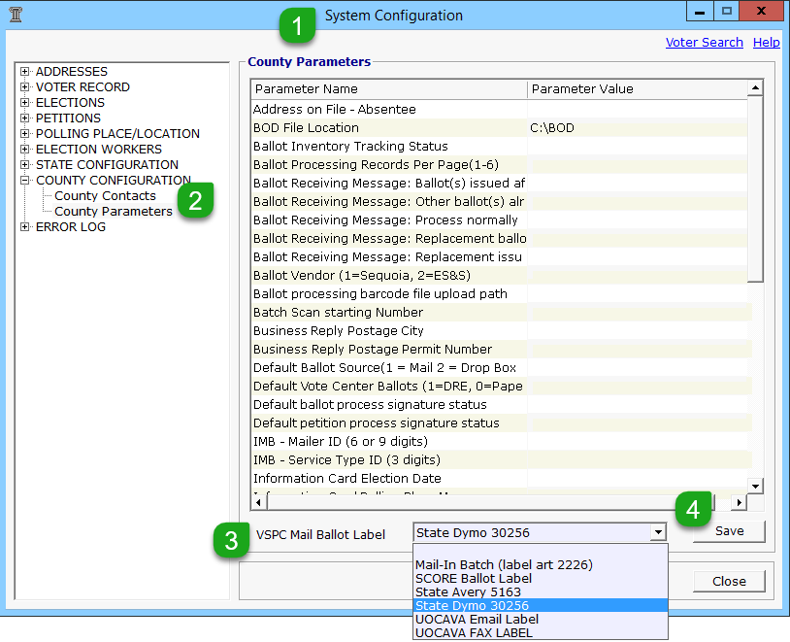
For a Primary Election
State Created VSPC Mail Ballot Label Setup
2
In SCORE Classic, open the System Configuration module
2. Select County Configuration > County Parameters
Use the drop-down arrow to select your VSPC Mail Ballot Label – State Dymo 30256 (If this larger label is not used packet information will not be displayed)
Note 1: If you do not select a Mail Ballot Label, then ePollbook will default to the SCORE Ballot Label.
Note 2: In-Person Paper and In-Person DRE (BMD) labels are hard-coded in ePollbook, so there is no setup needed for in-person labels.
Click the Save button
VC Programmer is not supported - scroll down to locate and confirm that both “VC Programmer Filename” and “VC Programmer Folder Location” fields are blank, so you do not receive an error message when issuing in-person ballots. Then click the Close button to exit System Configuration.

Slide 8
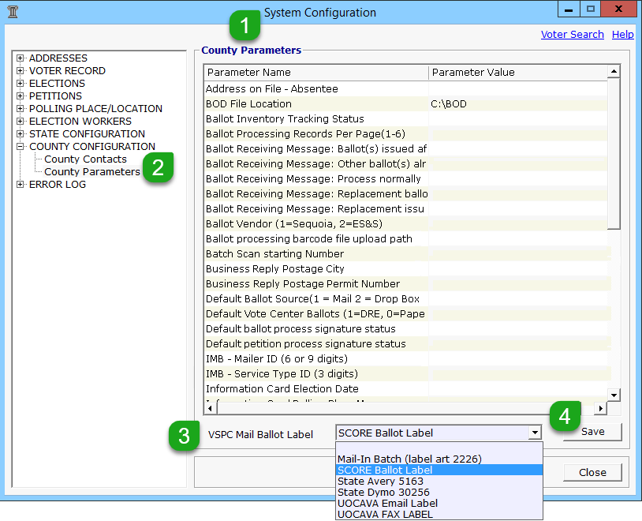
Elections Not a Primary
VSPC Mail Ballot Label Setup
3
In SCORE Classic, open the System Configuration module
2. Select County Configuration > County Parameters
Use the drop-down arrow to select the Mail Ballot Label your county chooses to use.
Note 1: If you do not select a Mail Ballot Label, then ePollbook will default to the SCORE Ballot Label.
Note 2: In-Person Paper and In-Person DRE (BMD) labels are hard-coded in ePollbook, so there is no setup or selection needed for In-Person labels.
Click the Save button
VC Programmer is not supported - scroll down to locate and confirm that both “VC Programmer Filename” and “VC Programmer Folder Location” fields are blank, so you do not receive an error message when issuing in-person ballots. Then click the Close button to exit System Configuration.

Slide 9
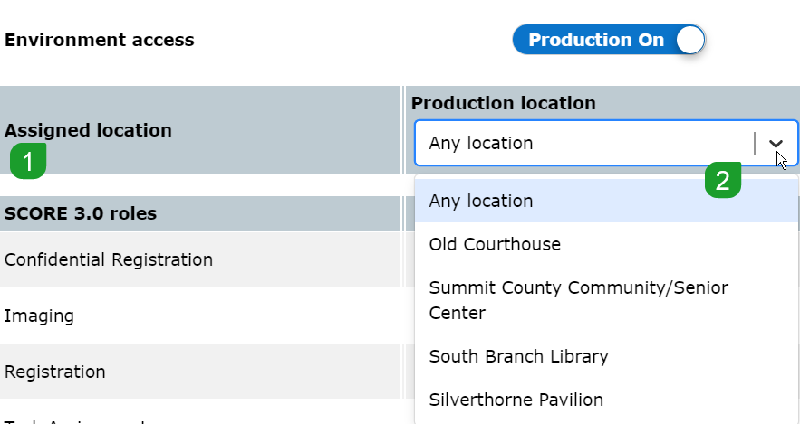
Assign VSPC Work Locations
4
All judges must be assigned a specific VSPC Work Location to access and issue ballots in ePollbook.
Exception: Judges that are given VSPC Change Location role and “Any Location” in Assigned location DO NOT need an assigned VSPC Work Location. “Any location” allows staff and judges to select any location after they log into ePollbook.
Best practice: Users should be assigned a specific work location. It is not good practice to give VSPC Change Location role and Any Location to judges. If they select the wrong location the ballot inventory will be off and create issues for more than one location.
Assign a location (often given at the time the account is created):
In SCORE 3.0 User Management application
Scroll down to Environment access section
Use the drop-down arrow to select the Assigned Location
Note: If a judge is relocated to another VSPC work location, the Assigned location must be modified in SCORE 3.0 User Management so they can issue ballots from the new location.

Slide 10
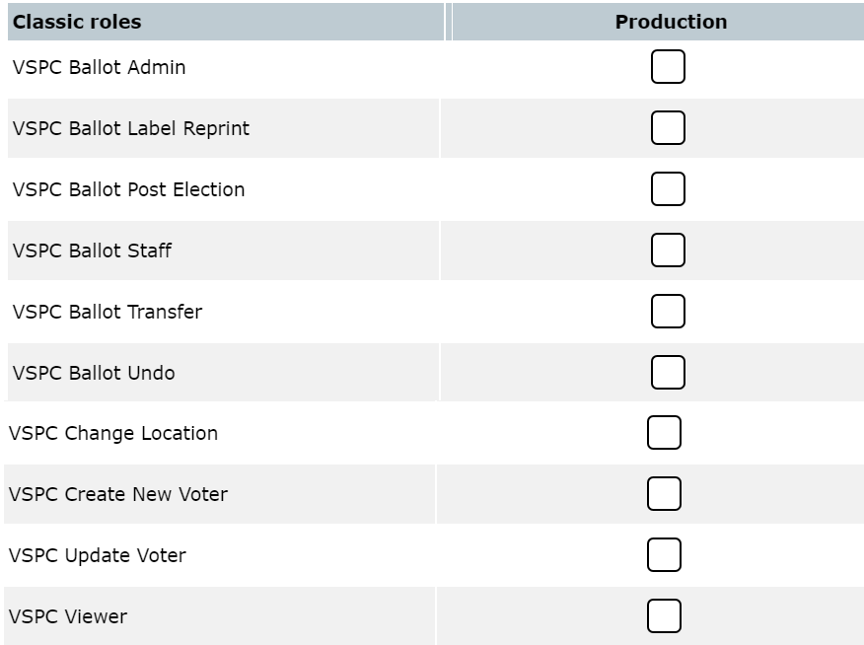
Assign VSPC User Roles
5
Assign User Roles
In SCORE 3.0 User Management application
Select the user’s name by clicking on it
Edit user window will open
Scroll down to the Classic roles section
Scroll down to the VSPC user roles and use the detailed chart on the next page to determine which user roles to assign

Slide 11
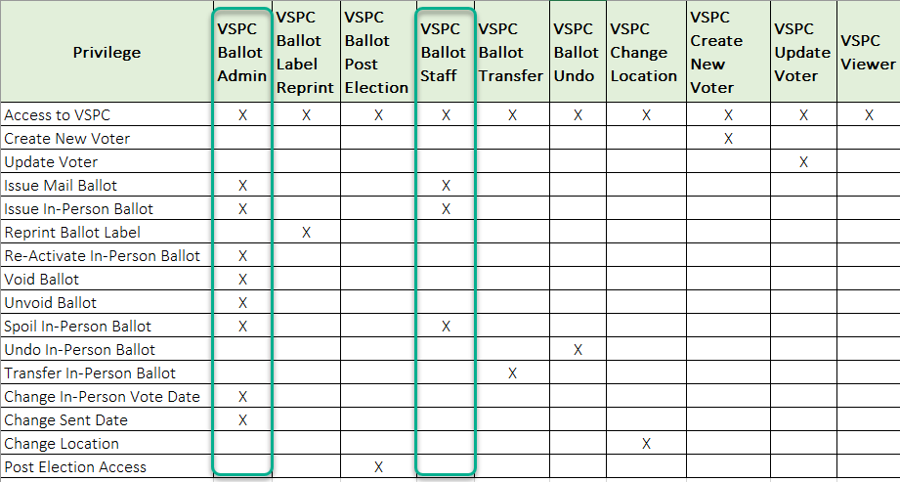
Assign VSPC User Roles
6
Assign User Roles
Review the VSPC Ballot Admin and VSPC Ballot Staff roles to determine which role to assign the user.
*The privileges for each role are listed in the far left column

Slide 12
Assign VSPC User Roles
VSPC Ballot Admin and VSPC Ballot Staff are conflicting roles and cannot coexist
7
VSPC Ballot Admin Role and VSPC Ballot Staff Role
In selecting the VSPC Ballot Admin role or the VSPC Ballot Staff role, the user is able to access ePollbook and issue and spoil ballots.
The two roles do not give the user the following privileges:
VSPC Ballot Label Reprint: Permits the user to reprint both mail ballot labels and In-Person ballot labels.
If the user does not have the role they will not see the button to reprint
VSPC Post Election Access: Permits the user to continue performing all of their roles after election day
VSPC Ballot Transfer: Permits the user to transfer the entire In-Person ballot activity from the current voter to another voter
VSPC Ballot Undo: Permits the user to undo In-Person paper or DRE (BMD) ballots
VSPC Change Location: Permits the user to change their VSPC work location and access to all VSPC locations
User with the VSPC Change Location role should have “Any Location” selected in Assigned location
VSPC Create New Voter: Permits the user to register a new voter
VSPC Update Voter: Permits the user to update the voter’s registration
The aforementioned bulleted roles were designed to give counties the ability to customize the user’s privileges. You may select any of the additional roles to augment the VSPC Ballot Admin or VSPC Ballot Staff roles.
Remember to click the Save button to save your selection(s)!

Slide 13
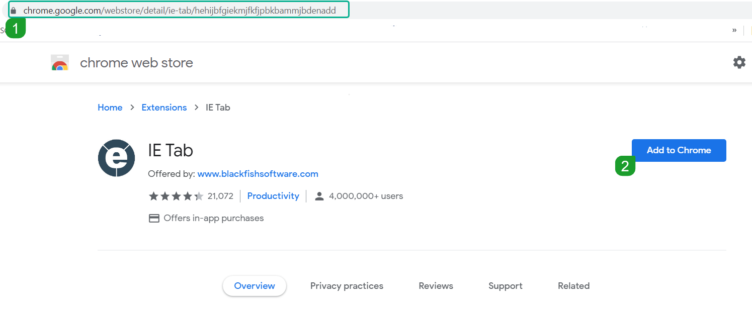
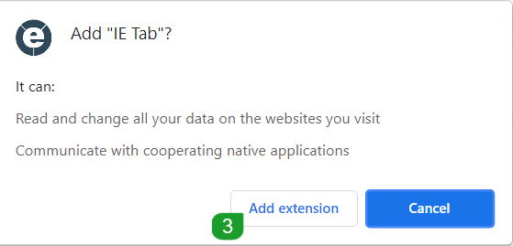
Add IE Extension for “ActiveX” in Chrome
*Only required for counties using the BOD printer
*Requires an Administrator to install. Contact your IT Department.
8
“ActiveX” must be enabled on all VSPC computers if your county will be printing ballots on the Ballot-On-Demand Printer from ePollbook. The following steps for adding ActiveX must be done:
Copy and paste into the URL:
https://chrome.google.com/webstore/detail/ie-tab/hehijbfgiekmjfkfjpbkbammjbdenadd
2. Select “Add to Chrome
3. New popup: Select Add extension

Slide 14
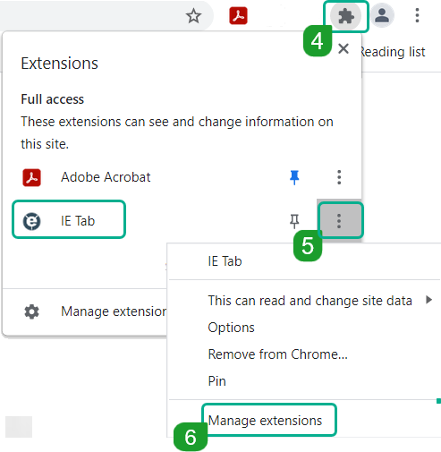
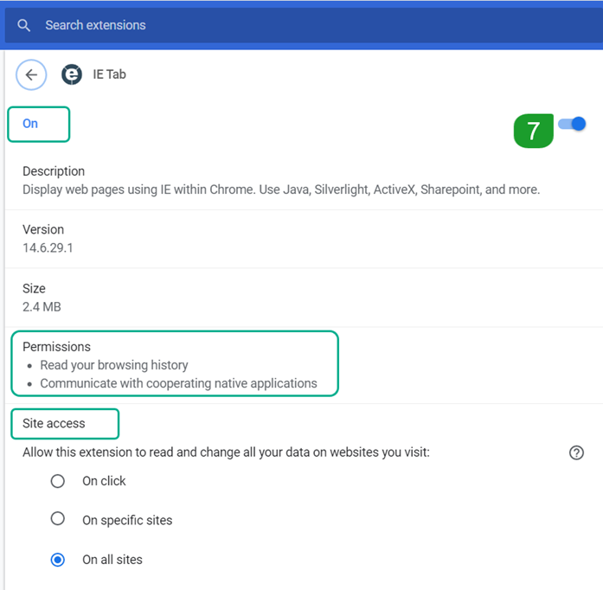
Add IE Extension for “ActiveX” (continued)
*Only required for counties using the BOD printer
*Requires an Administrator to install. Contact your IT Department.
9
4. Click on the puzzle piece to the right of the URL field
5. Click on More Actions for IE Tab
6. Click on Manage extensions
7. Turn On
8. The IE Tab Helper - IE Tab requires that the IE Tab Helper application be installed. The IE Tab Helper can be installed using our .MSI installer which can be found here: IE Tab Helper.
You must restart your computer!
NOTE: Extensions should only be added by your county IT department. Permissions and Site access and many other security permissions MUST be approved by your county IT department.

Slide 15
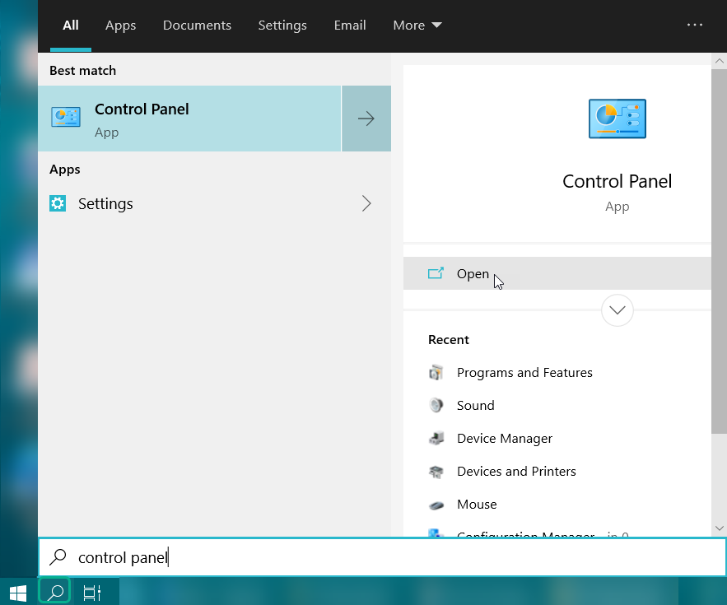
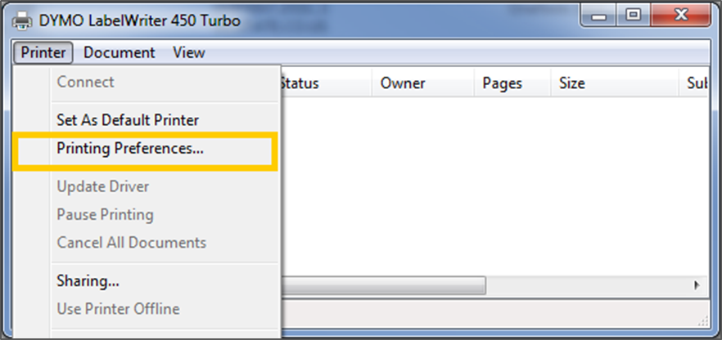
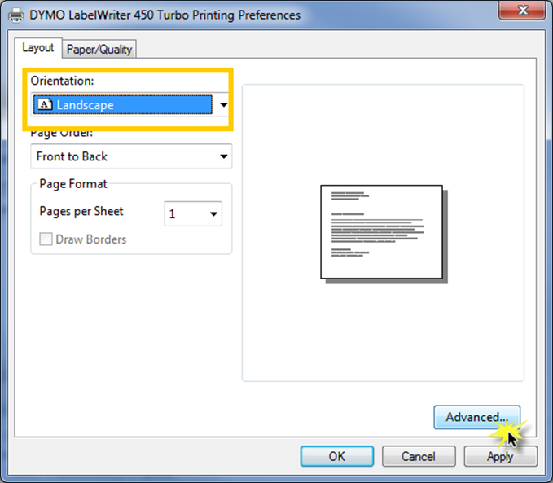
Adjust VSPC Ballot Label Printer Settings
10
Counties may need to adjust the printer settings for the VSPC Mail Ballot Label to receive a barcode which will scan. These steps should be done through the Windows 10 Control Panel versus the print label screen in ePollbook.
Select the Search icon in the lower-left of your screen
Type control panel in the search
Press “Enter” or use mouse and click on Open
Click on Devices and Printers
Click on your Dymo LabelWriter
Select Printer>Printing Preference… in the upper left corner
Ensure the Orientation is set at Landscape
Click on the Advanced button.

Slide 16

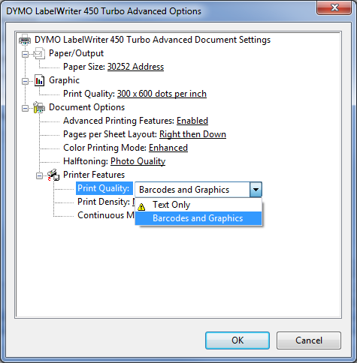
Adjust VSPC Ballot Label Printer Settings - continued
12
9. If you are printing a label with a barcode, locate Printer Features>Printer Quality and select Barcodes and Graphics.
10. Then click the OK button until the Dymo Labelwriter screen is fully closed
Reminder: Disable pop-up blockers, if printing ballot labels. Need assistance? The “How-to” is detailed on the next page.

Slide 17
Turn Off Pop-up Blockers
*Only required for counties printing ballot labels
12
Chrome
Edge
Open Chrome
At the top right, click the ellipsis icon
Click Settings
Click Privacy and security
Click Site settings
Scroll down to Content > Pop-ups and redirects
Customized behaviors
Allowed to send pop-ups and use redirects > Click Add
Enter the site address: https://webscore.coloradosos.gov
Click Add
Firefox
Open Edge
At the top right, click the ellipsis icon
Click Settings
Click Cookies and site permissions
Under Site permissions > All permissions
Click Pop-ups and redirects
Under Allow > click Add
Enter the site address: https://webscore.coloradosos.gov
Click Add
Open Firefox
At the top right, click the menu icon
Click Settings
Click Privacy & Security
Scroll down to Permissions > Block pop-up windows
Click the Exceptions box
Enter the site address: https://webscore.coloradosos.gov
Click Allow
Save Changes

Slide 18
Manage Vote Credit

Slide 19
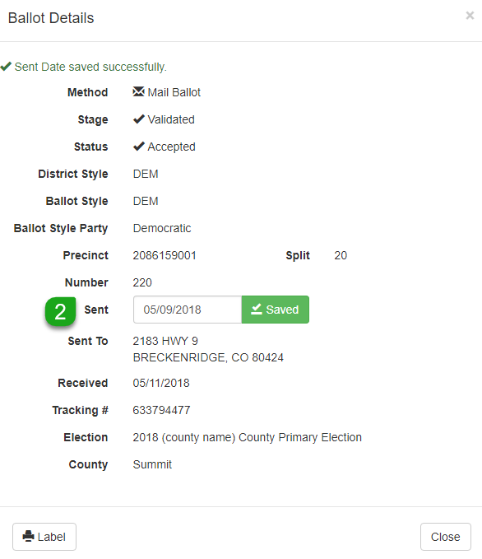
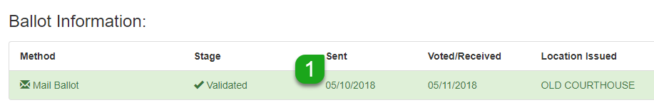
Change “Vote Date” or “Sent Date”
14
The user must be assigned the VSPC Ballot Admin role and the VSPC Ballot Post Election role if performing this process after election day.
Change a voter’s In-Person “Vote Date” or Mail Ballot “Sent Date”:
Open ePollbook and pull up the voter record that needs to be modified
Click on the correct ballot to open the Ballot Details screen
Enter the new Vote Date (or Sent Date) and click the Saved button
You will receive the message: “Vote Date (or Sent Date) saved successfully”.
Click the Close button to exit the screen

Slide 20
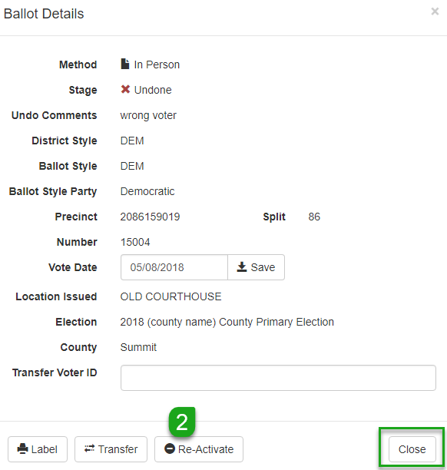
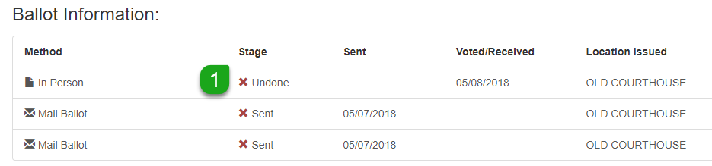
Reactivate Ballot
15
The user must be assigned the VSPC Ballot Admin role and the VSPC Ballot Post Election role if performing this process after election day.
Reactivate an “Undone” or ‘Spoiled” ballot:
Open ePollbook and pull up the voter’s record
Click on the correct ballot to open the Ballot Details screen
Click on the Re-Activate button
You will receive a message in the upper left corner “Ballot has been successfully reactivated”.
Click the Close button to exit the screen

Slide 21
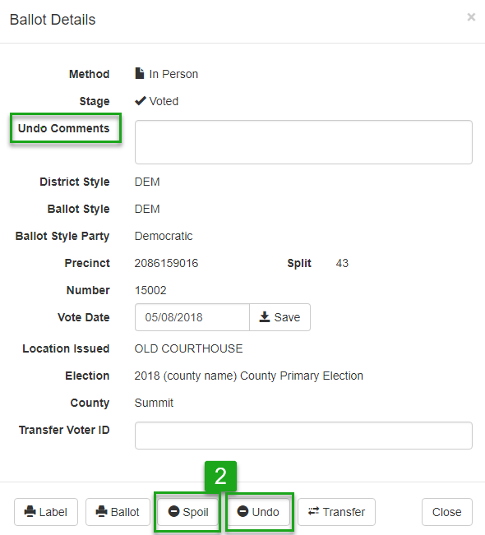
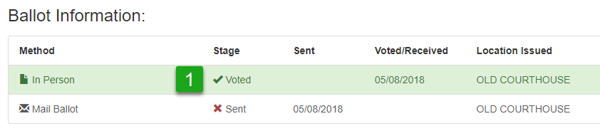
Remove Vote Credit
16
The user must be assigned the VSPC Ballot Admin privilege and the VSPC Ballot Undo privilege to complete this process, and the VSPC Ballot Post Election role if performing this process after election day.
Remove existing In-Person vote credit:
Open ePollbook and pull up the voter’s record
Click on the correct ballot to open the Ballot Details screen
If it’s an Administrative error:
Enter a comment in the “Undo Comments” field
and click the Undo button
If it’s a Voter Initiated error:
Click the Spoil button
Click the Close button to exit the screen
If Admin error enter a comment.

