Slide 1
Bipartisan Election Advisory Commission
January 26, 2017

Slide 2
Suggestions (pg. 1)
Eliminate first week of early voting at VSPCs in general election
Modify (or allow SOS to waive) parts of formulas
  Eliminate the first Saturday
  Decrease required number of VSPCs in first 6-10 days of early voting
  Waive formula based on geography/population centers
  Set/Waive formula based on throughput calculus
  Increase number of VSPCs on Monday and Election Day
  Adjust active voter tier (Create a 4th tier for counties and move thresholds)

Slide 3
Suggestions (pg. 2)
Require VSPC hours outside traditional work hours
Allow earlier ballot mailing dates
Explicitly allow mobile VSPC locations
Mandate/Encourage public schools serve as polling locations
Rules for county uniformity in VSPC public comment process
SOS review and approval of county VSPC plans
Set VSPC best practices (set-up and throughput) in rule

Slide 4
Total VSPC Transactions by Day

Slide 5
Transactions per VSPC per Day
(statewide)

Slide 6
Voter Propensity During Early Voting Period
Voter Propensity During Early Voting Period
Date Range | All Presidential Generals | All Even Year Generals | All Primaries | All Coordinateds
Oct 17th -30th | 64% | 35% | 14% | 29%
Oct 31st -Nov 7th | 53% | 25% | 7% | 17%
Election Day | 47% | 20% | 3% | 10%

Slide 7
VSPC Statewide Activity by Hour

Slide 8
VSPC Douglas County
Activity by Hour

Slide 9
VSPC El Paso County
Activity by Hour

Slide 10
CSU VSPC – Larimer County
Activity by Hour

Slide 11
VSPC Logan County
Activity by Hour

Slide 12
Selecting a VSPC
The El Paso County Example

Slide 14
El Paso County drive times

Slide 15
Specific Recommendations
Eliminate the first week of early voting
General election
  1-5-102.9(2) Voter service and polling centers must be open, at a minimum, for the fifteen-day period prior to and including the day of the election, except that voter service and polling centers are not required to be open on Sundays.
Primary and coordinated election
  1-7.5-107(4.5)(c) The minimum number of voter service and polling centers shall be open during, at a minimum, the eight days prior to and including the day of the election; except that voter service and polling centers are not required to be open on Sundays.

Slide 16
Modify VSPC formulas
  Eliminate the first Saturday
  Decrease number of VSPCs in first week of early voting
  Waive formula based on geography/population centers
  Set/Waive formula based on throughput calculus
  Increase number of VSPCs or throughput on Monday and Election Day
  Adjust thresholds and/or create a 4th tier for counties on Election Day:
    At least 50,000 active voters – require based on population
    50,000 to 20,000 – require 3
    20,000 to 10,000 – require 2
    10,000 and fewer – require 1

Slide 17
High Population County
VSPC Requirements
 | 2016 Active Pop | VSPCs 10.24 | VSPCs 11.5 | VSPCs 11.7 | VSPCs 11.8 | Statute 10.24 | Statute 11.8 | Primary Statute
Denver | 402,008 | 13 | 22 | 26 | 26 | 11 | 23 | 5
El Paso | 388,384 | 13 | 19 | 25 | 25 | 11 | 23 | 5
Arapahoe | 368,678 | 11 | 25 | 25 | 25 | 11 | 22 | 4
Jefferson | 384,559 | 12 | 12 | 12 | 24 | 11 | 23 | 5
Adams | 242,983 | 9 | 9 | 15 | 16 | 7 | 14 | 6
Larimer | 228,644 | 7 | 7 | 7 | 14 | 6 | 13 | 3
Douglas | 214,934 | 6 | 6 | 6 | 15 | 6 | 12 | 3
Boulder | 215,366 | 7 | 7 | 16 | 16 | 6 | 13 | 3
Weld | 162,863 | 5 | 5 | 5 | 15 | 4 | 9 | 3
Pueblo | 98,706 | 5 | 7 | 7 | 8 | 3 | 6 | 1
Mesa | 92,058 | 3 | 6 | 6 | 7 | 2 | 5 | 1
Broomfield | 43,255 | 2 | 3 | 3 | 3 | 1 | 3 | 1
La Plata | 36,737 | 2 | 3 | 3 | 3 | 1 | 3 | 2
Garfield | 31,845 | 2 | 2 | 2 | 7 | 1 | 3 | 2
Eagle | 30,334 | 3 | 4 | 4 | 4 | 1 | 3 | 2
Fremont | 26,725 | 1 | 1 | 1 | 3 | 1 | 3 | 1

Slide 18
Medium and Lower Population
VSPC Requirements
 | 2016 Active Pop | VSPCs 10.24 | VSPCs 11.5 | VSPCs 11.7 | VSPCs 11.8 | Statute 10.24 | Statute 11.8 | Primary Statute
Montrose | 24,819 | 1 | 2 | 2 | 3 | 1 | 3 | 1
Summit | 19,931 | 1 | 1 | 1 | 3 | 1 | 3 | 1
Delta | 19,591 | 1 | 2 | 2 | 3 | 1 | 3 | 1
Elbert | 18,152 | 1 | 1 | 1 | 3 | 1 | 3 | 1
Teller | 16,809 | 1 | 1 | 1 | 3 | 1 | 3 | 1
Routt | 16,937 | 1 | 1 | 1 | 3 | 1 | 3 | 1
Montezuma | 16,435 | 1 | 1 | 1 | 3 | 1 | 3 | 1
Morgan | 14,493 | 1 | 1 | 1 | 4 | 1 | 3 | 1
Chafee | 12,836 | 1 | 2 | 2 | 3 | 1 | 3 | 1
Pitkin | 12,705 | 1 | 1 | 1 | 3 | 1 | 3 | 1
Park | 12,475 | 1 | 2 | 2 | 3 | 1 | 3 | 1
Logan | 11,334 | 1 | 1 | 1 | 3 | 1 | 3 | 1
Otero | 10,683 | 1 | 1 | 1 | 3 | 1 | 3 | 1
Grand | 10,336 | 1 | 1 | 1 | 1 | 1 | 1 | 1
34 Counties | Under 10,000 | 1 | 1 | 1 | 1* | 1 | 1 | 1
*Gunnison County (9,804 pop) opened three VSPCs on Election Day 2016. Rio Blanco County (3,894 pop), San Miguel County (5,055), and Yuma County (5,307) each opened two VSPCs for 2016 General Election.

Slide 19
Current formula
General election (1-5-102.9(1)(a), C.R.S.)
  Each county clerk and recorder shall designate a minimum number of voter service and polling centers, as follows:
  For counties with at least twenty-five thousand active electors: (A) During the period designated for early voting, at least one voter service and polling center for each thirty thousand active electors; except that there must be at least one voter service and polling center in each such county; and (B) On election day, at least one voter service and polling center for every fifteen thousand active electors, but no fewer than three in each such county.
  For counties with at least ten thousand, but fewer than twenty-five thousand, active electors: (A) During the period designated for early voting, at least one voter service and polling center; and (B) On election day, at least three voter service and polling centers.
  For counties with fewer than ten thousand active electors: (A) During the period designated for early voting, at least one voter service and polling center; and (B) On election day, at least one voter service and polling center.
  The number of active electors in a county is the number of active electors registered in the county on the date of the previous presidential election.

Slide 20
Current formula
Primary and coordinated election (1-7.5-107(4.5)(a), C.R.S.)
  The county clerk and recorder shall designate voter service and polling centers equal to no fewer than the number of county motor vehicle offices in the county; except that each county shall have no fewer than one voter service and polling center, and, for counties with fewer than twenty-five thousand active electors, only one voter service and polling center is required.
  The county clerk and recorder may add additional voter service and polling center locations as necessary.
  The number of active electors in a county is the number of active electors registered in the county on the date of the previous presidential election.

Slide 21
Expand VSPC hours
Secretary of State Rule 7.9.1
  The county clerk must designate and open the minimum number of voter service and polling centers. The centers must be open during reasonable business hours for the minimum number of days outlined in section 1-5-102.9, C.R.S., for a general election and 1-7.5-107(4.5), C.R.S., for all other elections.
    Reasonable business hours means at least eight hours per day Monday through Friday, and at least four hours on Saturday.
    All voter service and polling centers must be open from 7:00 a.m. through 7:00 p.m. on election day.

Slide 22
Change ballot mailing deadlines
Current requirement (1-7.5-107(3)(a)(I), C.R.S.)
  Not sooner than twenty-two days before a general, primary, or other mail ballot election, and no later than eighteen days before the election, the county clerk and recorder or designated election official shall mail to each active eligible elector, at the last mailing address appearing in the registration records and in accordance with United States postal service regulations, a mail ballot packet, which must be marked "DO NOT FORWARD. ADDRESS CORRECTION REQUESTED.", or any other similar statement that is in accordance with United States postal service regulations.

Slide 23
Other Ideas
Explicitly allow mobile VSPC locations (permitted under current law)
  1-5-102.9(1)(c), 3, C.R.S. (minimum services each VSPC must provide)
Mandate/Encourage public schools serve as polling locations
Require county uniformity in VSPC public comment process
  1-5-102.9(1)(c)(II), C.R.S. (in designating VSPCs, a county clerk shall solicit public comments)
SOS review and approval of VSPC plans
  SOS Rule 7.1 (mail ballot plan review and approval)
    Number of VSPCs
    VSPC locations
    VSPC capacity
    VSPC set up process (Throughput?)
    Permit SOS to approve county variance requests
Put VSPC set up best practices in SOS rule

Slide 24
Other Ideas
Mandate a 24 hour drop box in each county
Permit counties to substitute enhanced 24/7 drop off locations for VSPC sites under certain circumstances.

Slide 25
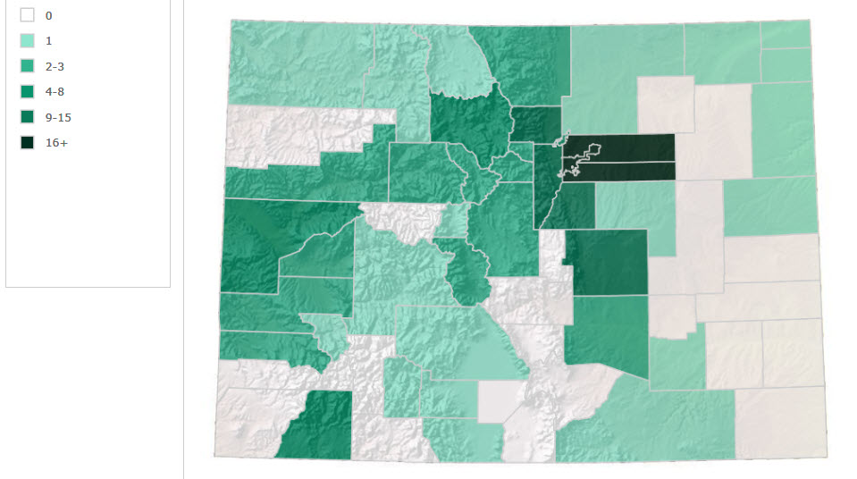
Early 2016 24 Hour Dropboxes

Slide 26
Dropbox Expansion
      Grant program to reimburse any county that wants to install a drop box
      Every county can apply for reimbursement for a percentage of the cost of installation and video surveillance for one drop box.
        Counties with fewer than 10,000 active voters: up to 90% of the total cost not to exceed $4,000
        Counties with more than 10,000 active voters: up to 80% of total cost not to exceed $4,000
      Counties can apply for consideration for additional reimbursement on a case by case basis

Slide 27
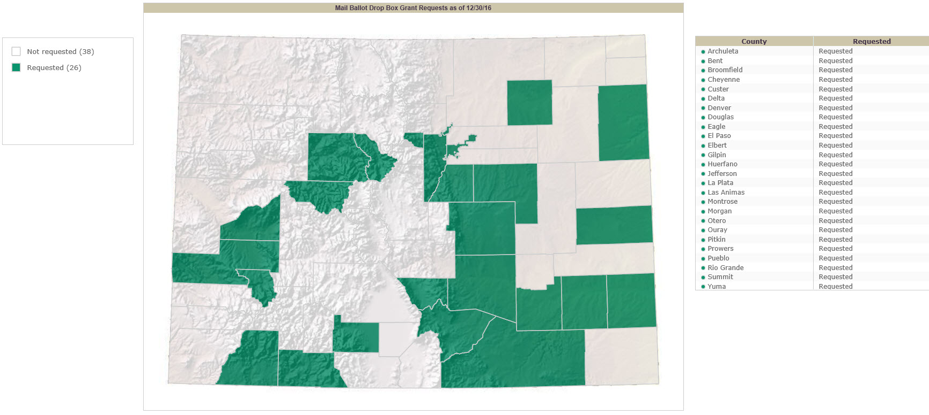
Dropbox Expansion

